Slide 1

Explainable Deep Learning Model For Pneumonia Diagnosis
Sl.No | Name | USN | Roll Number
1 | Gayatri Betageri | 01FE21BCS029 | 303
Guided By: Dr. Shantala Giraddi

Slide 2

Agenda
Introduction
Motivation
Problem Analysis
Problem Statement
Objectives
Methodology
Results
Conclusion
Future Scope
References

Slide 3

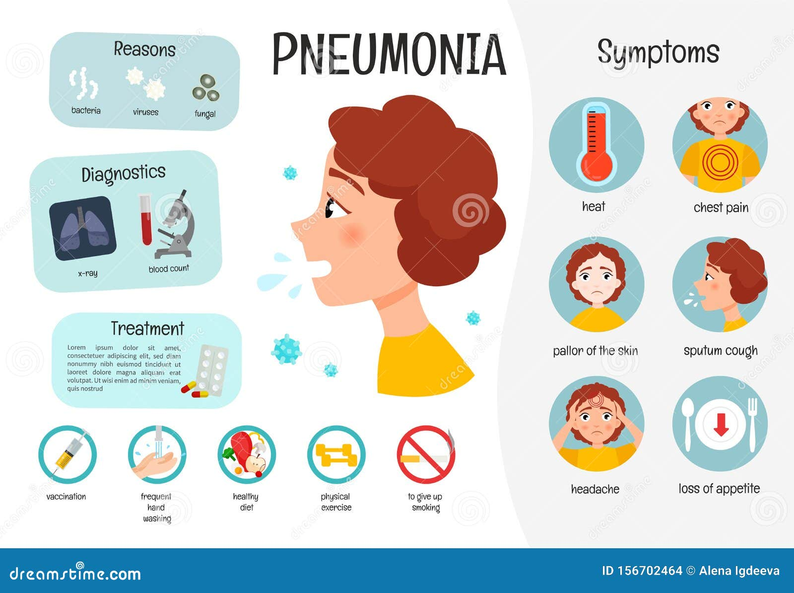
Introduction
Pneumonia is a lung infection that causes inflammation in the air sacs, leading to symptoms like cough, fever, difficulty breathing, and chest pain.
It can be caused by bacteria, viruses, or fungi and ranges from mild to severe, especially in young children, the elderly, and individuals with weakened immune systems.
Early diagnosis and treatment are crucial to prevent complications and improve recovery.

Slide 4
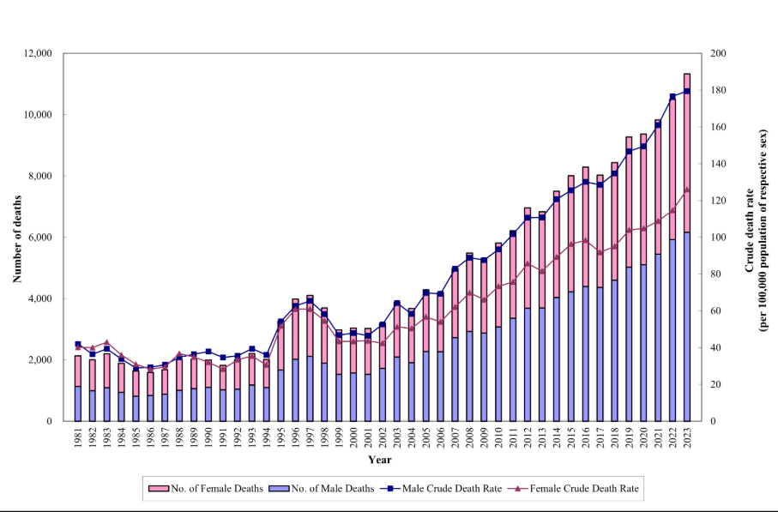
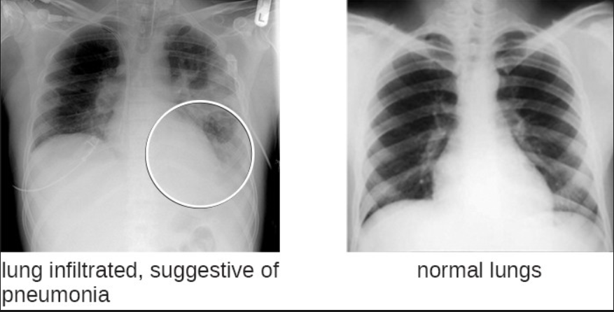
Introduction
The diagrams illustrate the differences between normal lungs and pneumonia-affected lungs in X-ray images, while the other image depicts the death rate associated with pneumonia(1984 – 2023).

Slide 5
Motivation
Importance of Early Diagnosis: Pneumonia requires timely detection for effective treatment and to reduce complications.
Lack of Interpretability: Traditional deep learning models act as “black boxes,” making it hard for doctors to trust their decisions.
Limited Clinical Adoption: Without transparency, AI-based medical tools struggle to gain acceptance in real-world healthcare settings.
Need for Explainability: Providing visual justifications for predictions can improve trust and usability for healthcare professionals.
Bridging AI and Healthcare: An explainable deep learning model enhances diagnostic confidence, improves patient outcomes, and ensures AI-driven tools are more reliable in medical practice.

Slide 6
Problem Analysis
Problem: Pneumonia diagnosis using deep learning lacks interpretability, making it difficult for healthcare professionals to trust model predictions.
Problem Cause: Traditional deep learning models act as "black boxes," failing to highlight critical lung regions that influence diagnosis.
Problem Solution: This project develops an explainable deep learning model that not only detects pneumonia but also provides interpretable visual explanations.
Process of Solution: The model utilizes attention mechanisms or Grad-CAM to highlight key lung areas, improving transparency. It is trained on chest X-ray datasets, evaluated for accuracy, and deployed for clinical validation, ensuring reliable and interpretable diagnosis.

Slide 7
Problem statement
“Explainable Deep Learning Model For Pneumonia Diagnosis”

Slide 8
Objectives
To enhance model interpretability for pneumonia diagnosis by integrating LIME with CNN and Grad-CAM with InceptionV3, ensuring clear and interpretable AI predictions.
To improve diagnostic accuracy and reliability by optimizing deep learning models for high accuracy in pneumonia detection while maintaining robust and consistent predictions.
To optimize computational efficiency for real-world deployment by reducing GPU training time and energy consumption, making the model suitable for resource-constrained medical environments.

Slide 9
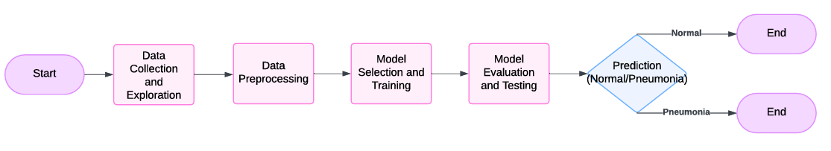
Methodology
Fig 1 : System Flow Diagram

Slide 10
Data Collection & Exploration
Dataset Composition: Contains 5,856 carefully selected and verified chest X-ray images for pneumonia identification.
Focus on AP Views: Emphasizes anterior-posterior (AP) chest X-ray views from pediatric patients aged 1 to 5.
Dataset Categories: Divided into three sets – training, testing, and validation.
Labeling: Images are labeled as NORMAL (healthy lungs) or PNEUMONIA (infected lungs).
Size: The dataset is approximately 1.24 GB.
Purpose: Designed to facilitate training, testing, and evaluation of deep learning models for pneumonia detection.
Data Quality: Underwent rigorous validation to ensure high-quality images, improving diagnostic efficiency and accuracy. (Check for image quality issues such as noise, brightness variations, or artifacts.)

Slide 11
Data Preprocessing
Resizing Images – Ensuring all images have the same dimensions (e.g., 224x224 or 299x299) for consistency.
Normalization – Scaling pixel values between 0 and 1 to improve training efficiency.
Data Augmentation – Applying transformations like rotation, flipping, and zooming to enhance model generalization.
Splitting Dataset – Dividing the dataset into training, validation, and testing sets.
Label Encoding – Converting categorical labels (NORMAL/PNEUMONIA) into numerical values for model training

Slide 12
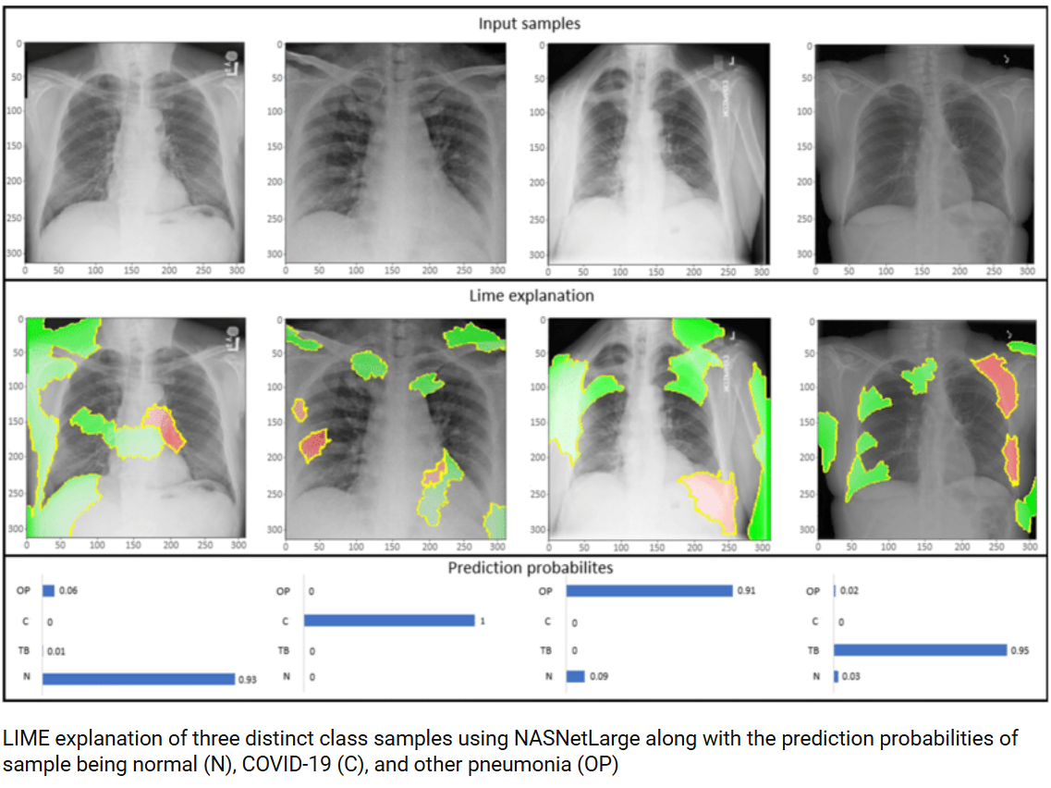
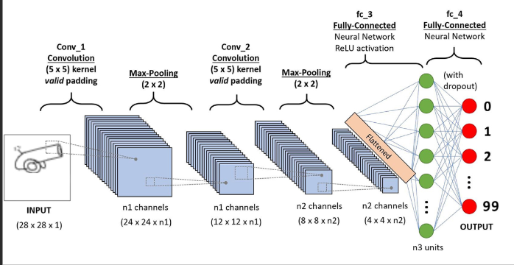
Model Selection & Training
Model 1: Convolution Architecture with LIME (Local Interpretable Model-agnostic Explanations.)
Fig 2:CNN Architecture
Fig 3: LIME

Slide 13
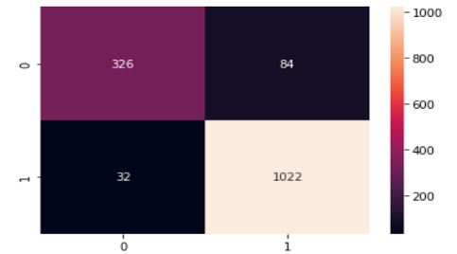
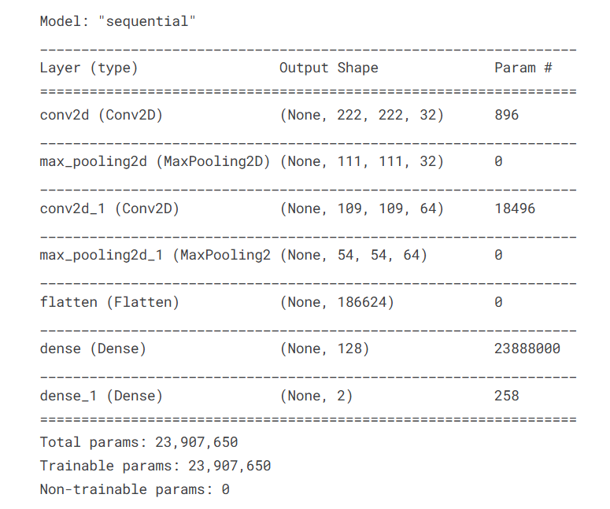
Results of Model 1
Figure 2 most likely represents the confusion matrix for the CNN model, visually displaying the number of true positives, false positives, true negatives, and false negatives in pneumonia classification.
It provides insights into the model's classification performance, showing the ability to distinguish between normal and pneumonia cases.
Fig 5: Total Parameters
Fig:4 : Confusion Matrix

Slide 14
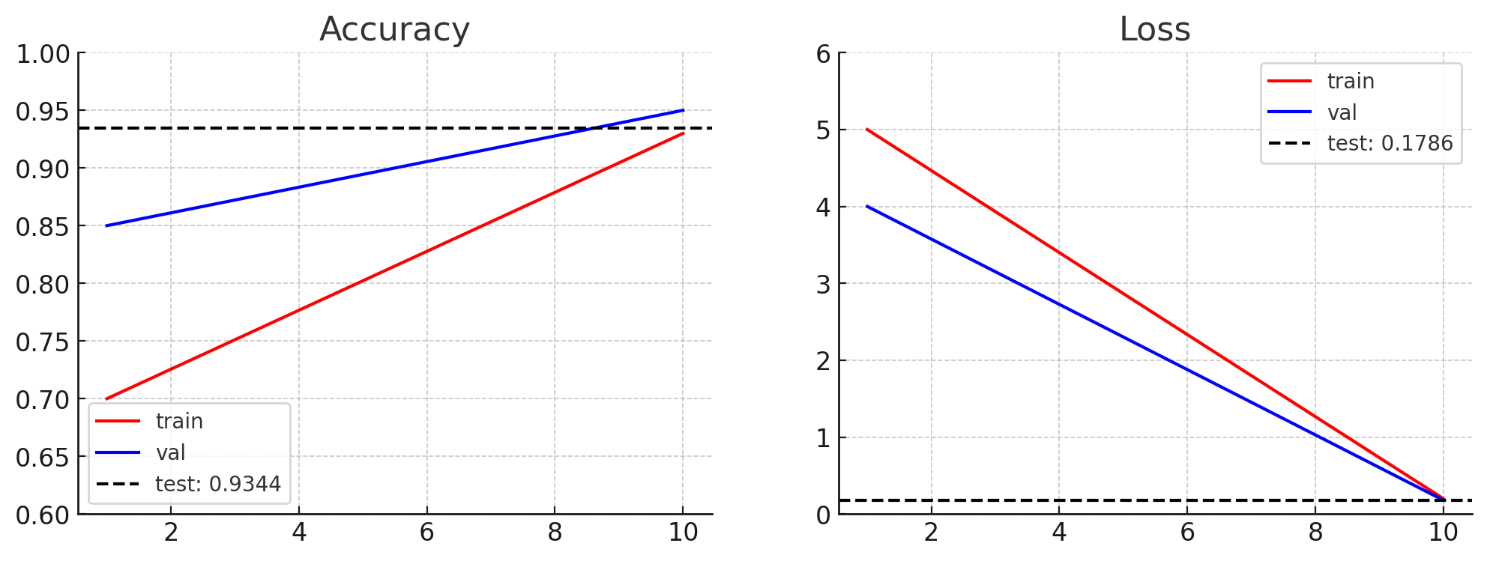
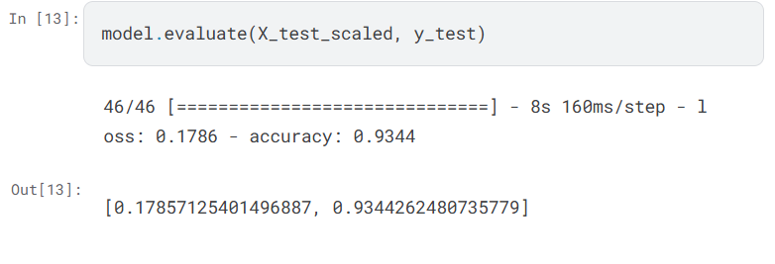
Results of Model 1
Line Graph Showing Accuracy and Loss Trends: 93% Accuracy with a Loss of 0.1786
Fig.6 : Graph Showing the Model Performance

Slide 15
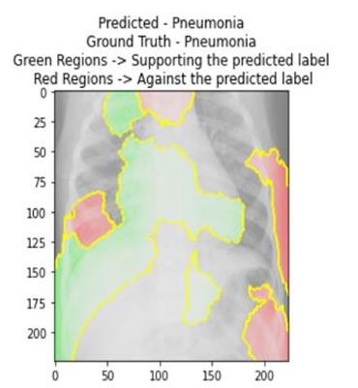
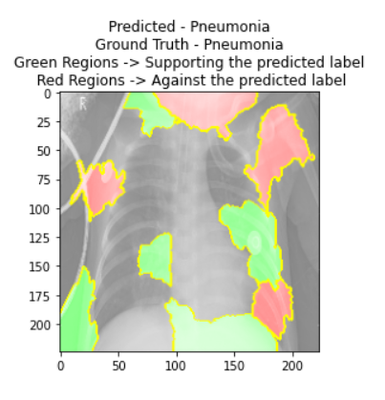
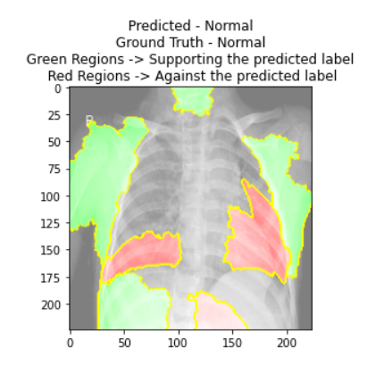
Results of Model 1
Figure 7 shows Results discussing the use of LIME (Local Interpretable Model-Agnostic Explanations) for explainability. The report states that LIME provides local explanations by highlighting the specific areas of an X-ray image that influenced the model’s decision.
Fig.7 : Results

Slide 16
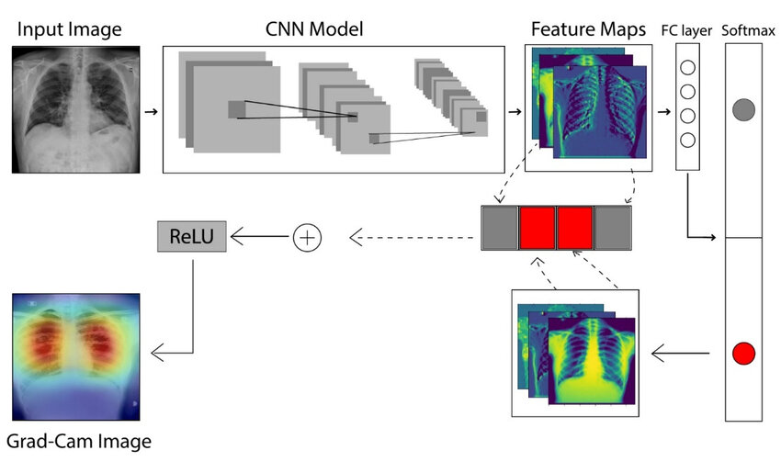
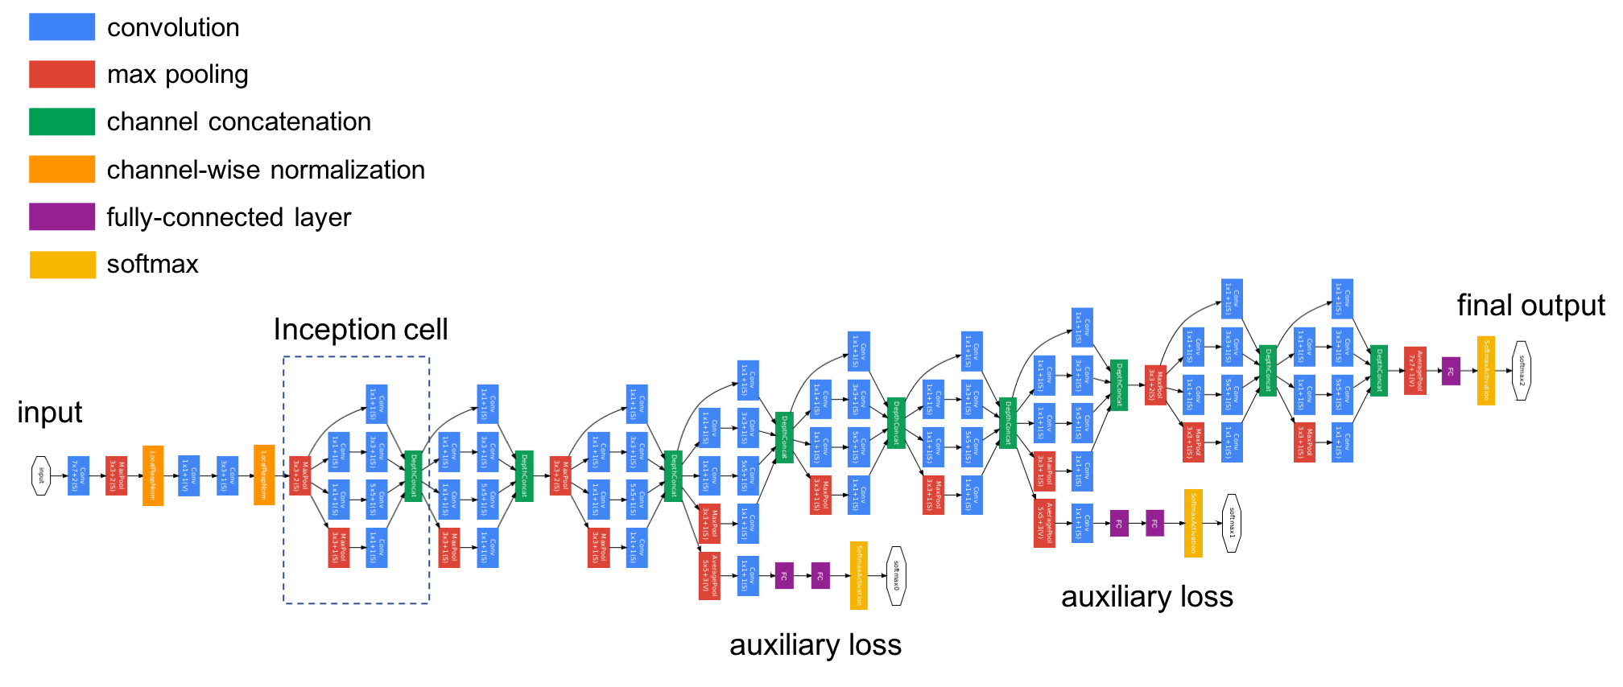
Model Selection & Training
Model 2: GRAD-CAM(Gradient-weighted Class Activation Mapping) & INCEPTION-V3
Fig.8 : GradCam Architecture
Fig.9: Inception-v3 Architecture

Slide 17
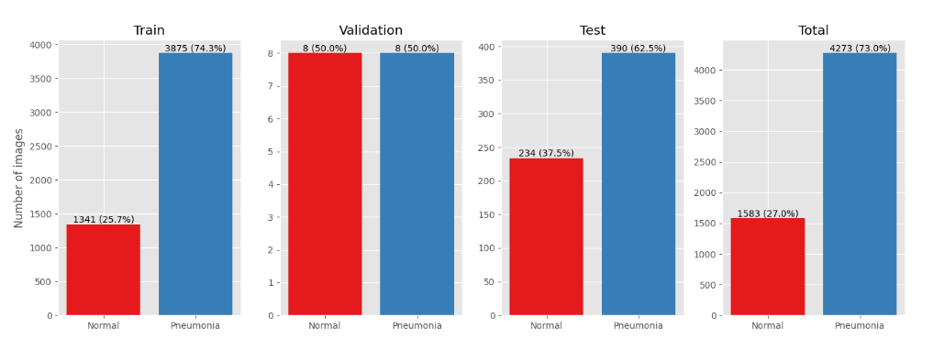
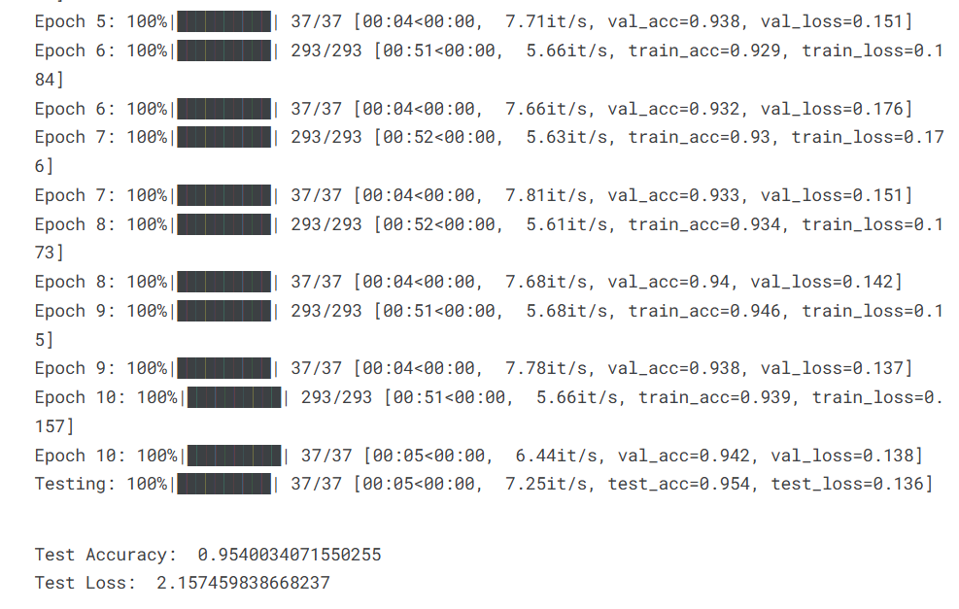
Results of Model 2
Figure 10 shows the Training and evaluation results for pneumonia classification: The dataset distribution across train, validation, and test sets highlights a class imbalance. Figure 11 achieves a test accuracy of 95.4% with a loss of 2.16, demonstrating strong performance in pneumonia detection."
Fig.10
Fig .11

Slide 18
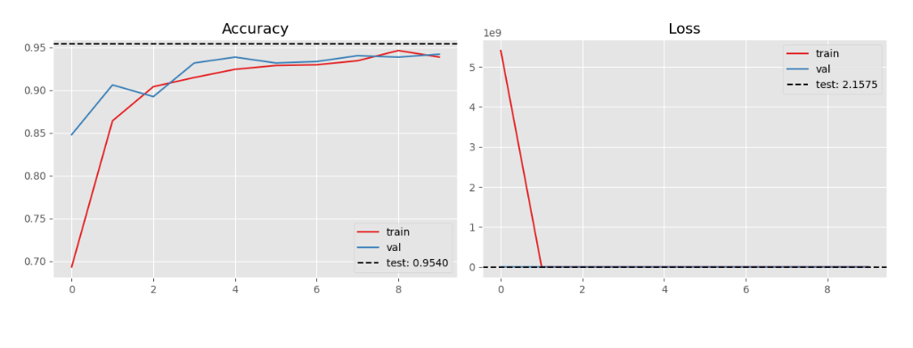
Results of Model 2
Figure 12 a Line graph showing accuracy and loss trends during training: The model achieves a final test accuracy of 95.4%, with accuracy improving steadily across epochs. The loss graph indicates a sharp decrease initially, stabilizing in later epochs with a final test loss of 2.16."
Fig.12

Slide 19
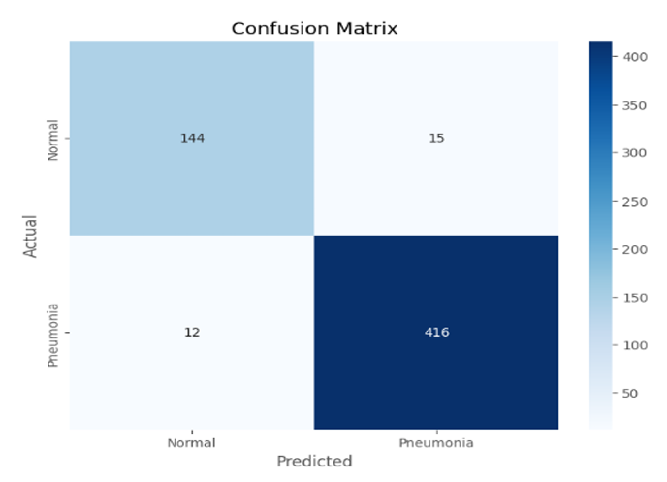
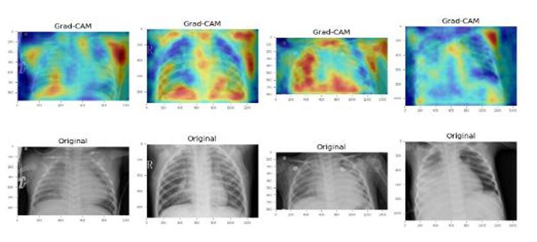
Results of Model 2
Figure 13 showing the Confusion matrix illustrating the model’s classification performance for pneumonia detection. The matrix shows correctly classified and misclassified cases for normal and pneumonia conditions.
Figure 14 showing the Grad-CAM visualizations highlighting important regions in chest X-rays used by the model for pneumonia classification, along with the corresponding original images.
Fig.13
Fig.14

Slide 20
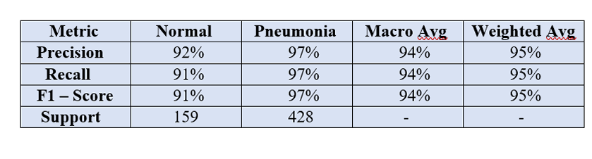
Results of Model 2
Figure 15 describing the Classification report showing precision, recall, and F1-score for pneumonia detection. The model achieves high performance across both normal and pneumonia cases, with overall macro and weighted averages of 94% and 95%, respectively.
Fig.15

Slide 21
Results Analysis (Conclusion)
The performance comparison highlights the superiority of the InceptionV3 model enhanced with Grad-CAM over the CNN model with LIME. The second graph (right) demonstrates higher accuracy (95%) and better loss convergence, indicating a more reliable and interpretable approach for pneumonia diagnosis. This reinforces the effectiveness of InceptionV3 with Grad-CAM in clinical applications, making it a preferable choice for real-world deployment.

Slide 22
Future Scope
Enhancing Model Generalization
Expand the dataset to include diverse age groups, geographical variations, and different clinical conditions to improve robustness.
Fine-tune the model with real-world hospital data for better adaptation to varied medical imaging scenarios.
Multi-Disease Diagnosis
Extend the model to detect multiple respiratory diseases, such as tuberculosis, lung cancer, and COVID-19, using the same deep learning framework.
Incorporate multi-modal learning by integrating X-ray images with patient history and symptoms for more comprehensive diagnostics.
Improved Explainability and Trust
Enhance interpretability techniques by combining Grad-CAM, LIME, and SHAP for more detailed visual and textual explanations.
Conduct usability studies with medical practitioners to refine the model’s explanations for better acceptance in clinical practice.
Scalable Remote Diagnostics
Implement a cloud-based AI system for real-time consultation and analysis of chest X-rays.
Optimize the model for deployment on mobile and edge devices to assist pneumonia diagnosis in remote and low-resource settings.

Slide 23
References
1.Rajpurkar P, Irvin J, Ball RL, Zhu K, Yang B, Mehta H, et al. Deep learning for chest radio graph diagnosis: A retrospective comparison of the CheXNeXt algorithm to practicing radiologists. PLoS Med. 2018;15(11):e1002686. doi: 10.1371/journal.pmed.1002686. PubMed PMID: 30457988. PubMed PMCID: PMC6245676.
2. Elshennawy NM, Ibrahim DM. Deep-Pneumonia Framework Using Deep Learning Models Based on Chest X-Ray Images. Diagnostics (Basel). 2020;10(9):649. doi: 10.3390/diag nostics10090649. PubMed PMID: 32872384. PubMed PMCID: PMC7554804.
3. Chouhan V, Singh SK, Khamparia A, Gupta D, Tiwari P, Moreira C, Damaševičius R, De Albuquerque VH. A novel transfer learning based approach for pneumonia detection in chest X ray images. Applied Sciences. 2020;10(2):559. doi: 10.3390/app10020559.
4. H. Wei, Y.Cheng, Pneumonia ct image scoring method, involves predict ing second score of ct image according to image feature and pre-trained scoring model, and fusing first score and the second score to determine f inal score of ct image.
5. T. Kuth, R.Rupprecht, Computer aided diagnosis and therapy for patients suffering from pneumonia based on mri scans uses historical patient data to establish diagnosis and determine therapy.
6.V. Chouhan, S. K. Singh, A. Khamparia, D. Gupta, P. Tiwari, C. Moreira, R. Damasevicius, V. H. C. de Albuquerque, A novel transfer learning based approach for pneumonia detection in chest x-ray images, Applied Sciences-Basel 10 (2).

Slide 24
References
7. 1. I. D. Apostolopoulos, T. A. Mpesiana, Covid-19: automatic detection from x-ray images utilizing transfer learning with convolutional neural networks, Physical and Engineering Sciences in Medicine 43 (2) (2020) 635–640
8. T. Mahmud, M. A. Rahman, S. A. Fattah, Covxnet: A multi-dilation convolutional neural network for automatic covid-19 and other pneumo nia detection from chest x ray images with transferable multi-receptive feature optimization, Computers in Biology and Medicine 122.
9. F. Piccialli, V. Somma, F. Giampaolo, S. Cuomo, G. Fortino, A survey on deep learning in medicine: Why, how and when?, Information Fusion 66 (2021) 111–137. doi:10.1016/j.inffus.2020.09.006.
10. K.-L. Hua, C.-H. Hsu, H. C. Hidayati, W.-H. Cheng, Y.-J. Chen, Computer-aided classification of lung nodules on computed tomography images via deep learning technique, Oncotargets and Therapy 8 (2015) 2015–2022.
11. H.-C. Shin, H. R. Roth, M. Gao, L. Lu, Z. Xu, I. Nogues, J. Yao, D. Mollura, R. M. Summers, Deep convolutional neural networks for computer-aided detection: Cnn architectures, dataset characteristics and transfer learning, Ieee Transactions on Medical Imaging 35 (5) (2016) 1285–1298.
12. L. A. Rousan, E. Elobeid, M. Karrar, and Y. Khader, “Chest xray findings and temporal lung changes in patients with covid-19 pneumonia,” Bmc Pulmonary Medicine, vol. 20, no. 1, 2020.
13. W. Zhu, C. Liu, W. Fan, X. Xie, Ieee, DeepLung: Deep 3D Dual Path Nets for Automated Pulmonary Nodule Detection and Classification, IEEE Winter Conference on Applications of Computer Vision, 2018.

Slide 25
References
14. R. R. Selvaraju, M. Cogswell, A. Das, R. Vedantam, D. Parikh, and D. Batra, “Grad cam: Visual explanations from deep networks via gradient-based localization,” International Journal of Computer Vision, vol. 128, no. 2, pp. 336–359, 2020.
15. de Benedictis, F.M.; Kerem, E.; Chang, A.B.; Colin, A.A.; Zar, H.J.; Bush, A. Complicated pneumonia in children. Lancet 2020, 396, 786–798.
16. Wang, J.; Zhu, H.; Wang, S.H.; Zhang, Y.D. A review of deep learning on medical image analysis. Mob. Netw. Appl. 2021, 26, 351–380.
17. Puttagunta, M.; Ravi, S. Medical image analysis based on deep learning approach. Multimed. Tools Appl. 2021, 80, 24365–24398.
18. Atasever, S.; Azginoglu, N.; Terzi, D.S.; Terzi, R. A comprehensive survey of deep learning research on medical image analysis with focus on transfer learning. Clin. Imaging 2023, 94, 18–41.
19. Sharma, S.; Guleria, K. A systematic literature review on deep learning approaches for pneumonia detection using chest X-ray images. Multimed. Tools Appl. 2023, 1 51.
20. Khan, W.; Zaki, N.; Ali, L. Intelligent pneumonia identification from chest X-rays: A systematic literature review. IEEE Access 2021, 9, 51747–51771.
21. Kundu, R.; Das, R.; Geem, Z.W.; Han, G.T.; Sarkar, R. Pneumonia detection in chest X-ray images using an ensemble of deep learning models. PLoS ONE 2021, 16, e0256630.

Slide 26
References
22. Gabruseva, T.; Poplavskiy, D.; Kalinin, A. Deep learning for automatic pneumonia detection. In Proceedings of the IEEE/CVF Conference on Computer Vision and Pattern Recognition Workshops, Seattle, WA, USA, 14–19 June 2020; pp. 350–351.
23. Jain, R.; Nagrath, P.; Kataria, G.; Kaushik, V.S.; Hemanth, D.J. Pneumonia detection in chest X-ray images using convolutional neural networks and transfer learning. Measurement 2020, 165, 108046.
24. Iparraguirre-Villanueva, O.; Guevara-Ponce, V.; Roque Paredes, O.; Sierra-Liñan, F.; Zapata-Paulini, J.; Cabanillas-Carbonell, M. Convolutional Neural Networks with Transfer Learning for Pneumonia Detection. 2022.

Slide 27
Thank You

